Slide 1
IMPLEMENTING AN AUTO-INDEXING ALGORITHM WITHIN AN EXTENSION ON POSTGRESQL’S PLATFORM.
DRAGON TRAN, CHARLES JOHNSON, CHARLIE LIU, EMILY BLACK
YOUTUBE PRESENTATION: https://youtu.be/h5YKgJgQ9mw

Slide 2
PRESENTATION OUTLINE:
Introduction
Our Project
Our Objectives
Why
Related Work
Proposed Work & Results
Past Attempts & Obstacles
Our Algorithm
Dexter’s Integration
Benchmarking & Results
Conclusions & Future Work
Notes:
In this presentation we will be discussing the ideas behind our project, what objectives we sought to accomplish and why our research is important
we will discuss some related works that have been done in the same area.
our proposed work and results, our past attempts & obstacles, our algorithm, dexter’s integration, benchmarking and result
finally, we will explain our conclusions and proposed future work

Slide 3
INTRODUCTION

Slide 4
INTRODUCTION: OUR PROJECT
Implement an auto-indexing algorithm on PostgreSQL’s platform
Auto-indexing implications
The Index Selection Problem
The algorithm implemented
Notes:
Speaker: TJ
bullet 1: The idea behind our project is to implement an auto-indexing algorithm on PostgreSQL’s platform
bullet 2: Auto-indexing alone implies some sort of intelligence behind the actual algorithm itself. It implies that an algorithm, given a continuous flow of work (queries), will intelligently re-calculate based on the current workload, and previous workloads before that
bullet 3: This is an intelligent way to go about the Index Selection Problem (ISP). The ISP is essentially the problem of finding the best set of indices given a database. The goal of the ISP “is to choose a subset of given indexes to be created in a database, so that the response time for a given database workload is minimized.” ^{[1]} This problem sounds incredibly easy to solve on the surface, but it actually turns out this is one of the biggest and hardest NP problems that modern day database administrators (DBA) still face
bullet 4: The algorithm we will be using will be a branch off of Mujiba Zaman’s algorithm, defined in her thesis work, and cited below.

Slide 5
INTRODUCTION: OUR OBJECTIVES
Re-creation and modification of Zaman’s algorithm as to not copy her work directly.
Locating specific Dexter file(s) related to auto-indexing and hook it up with our python script.
Comparing results from Dexter and our algorithm and finding the most optimal set of new indices.
Increasing overall performance of the database given our new indices.
Notes:
Speaker: Emily
So our project boils down to four different objectives: re-creation and modification of Zaman’s algorithm as to not copy her work directly. (getting rid of threshold2, not calling PostgreSQL’s optimizer, etc.)
Our next objective was to locate specific Dexter file(s) relating to auto-indexing and hook it up with our python script. We mainly decided to use Python because of it’s amazing set of external libraries, that can do tons of things, including clustering.
Another objective is to compare results from Dexter and our algorithm, and find the most optimal set of new indices between the two. The more results the better, so we figured why not compare results instead of just scraping Dexter’s results and using only our own.
And lastly, our final objective was to increase the overall performance of the database given our new indices. We’ll go into detail later how we benchmarked, what we used to benchmark, and what our results were.

Slide 6
INTRODUCTION: WHY
Lessen the daily workload of a database administrator
Improve overall database performance
As the volume and speed at which data is processed, auto-indexing plays a critical role in supporting query processing and optimization
Notes:
Speaker: TJ
Our algorithm not only lessens the workload of the DBA, but also helps improve the overall performance of the database itself. as the pace of generated data gets faster and faster and the amount of data processed gets bigger and bigger, the index technique has been playing a more critical role then ever before to support query processing and optimization. having an auto-indexing an auto-indexing algorithm that utilizes modern day artificial intelligence techniques to continuously re-generate a set of new indices given workload changes makes a huge impact on a DBA’s job and allows the DBA to focus on other tasks at hand.

Slide 7
RELATED WORK

Slide 8
RELATED WORK:
HypoPlan - a non-intrusive and completely autonomous approach to database self-tuning.
Continuous On-Line Tuning (COLT)- Framework that supports the on-line materialization of index structures.
Automatic Index Selection Integrated into Optimizer (AISIO) - Using the built-in database management system optimizer can lead to better performance than external tools.
Semi-Automatic Index Tuning, WFIT - Database administrator feedbacks can still significantly improve the quality of recommendations
Notes:
Speaker: TJ (HypoPlan + COLT) + Charlie (AISIO + Semi-Auto)
//script goes here
TJ:
Hypoplans is a non-intrusive and completely autonomous approach to database self tuning. it operates in three phases, observation, prediction and reaction. during observation the db workload is monitored and candidate structures for design tuning are identified. the prediction phase attempts to predict the outcome if a design change was made, and the reaction phase is where candidate structures are implemented.
COLT, short for continuous On-Line Tuning is a framework that supports the on-line materialization of index structures. COLT follows a similar pattern of observe, predict, and react, but what sets COLT apart is its ability to maintain its overhead cost by increasing or decreasing the amount of work it does according to the database workflow.
Charlie:
Automatic Index Selection Integrated into Optimizer, or AISIO, is a work done by Pedrozo and Gomes Vaz. In their study they compared using external tools for index selection vs. using the DBMS to select index. Their study proved a similar level of performance can be achieved using the built-in DBMS optimizer when compared to an external tool, without the extra cost of implementing external tools. But external tools can be used if the specific desirable metric is not considered by the DBMS optimizer.
Schnaitter & Polyzotis investigate the potential benefit of a semi-automatic approach to indexing where database administrators can provide feedbacks to an automated index selection algorithm to encourage or discourage certain indexes from being created. They concluded a better optimized database is possible with this approach, but only with immediate and accurate feedback from the database administrator.

Slide 9
PROPOSED WORK & RESULTS

Slide 10
PROPOSED WORK & RESULTS: PAST ATTEMPTS & OBSTACLES
Originally thought we could just change PostgreSQL’s source files => roadblock
Aimed at creating our own extension on PostgreSQL in order to implement an auto-indexing method on top of PostgreSQL => roadblock
Finally decided to use our algorithm with Dexter
The main obstacle we currently still face is the learning curve of Ruby
Notes:
Speaker: Emily
So before we get into what work we’ve done and it’s results, we’d also like to point out the past attempts we’ve had with this project, and the obstacles we still currently face. Initially way way back when we first declared our project proposal, none of us had ever used PostgreSQL. We thought we could just implement two clustering and non-clustering algorithms within the source files, test it, and call it a day. It took us about half a month to a month to realize that wasn’t possible, and that PostgreSQL actually doesn’t do any auto-indexing. This means that we needed to create an extension for PostgreSQL before implementing our auto-indexing algorithm, which leads to our second roadblock.
We thought we could take on the task of creating a whole new extension on top of PostgreSQL, and then implementing our auto-indexing algorithm on top of that. This is where our second roadblock comes in. We wanted to try to structure our new extension around Dexter, since Dexter is incredibly efficient, but Dexter alone is roughly 1,000 lines of Ruby, and wouldn’t of been feasible given the remaining time left in the semester. Plus none of us have ever coded nor had a course in Ruby, so the learning curve would of been massive.
So with those two big roadblocks behind us, we finally settled on implementing our algorithm on top of Dexter, and comparing the results of the two to produce a final set of indices that should be indexed. As easy as this sounds, it was still incredibly hard for us, because it still required us to read through Dexter and understand what it’s algorithm does and how it does it.
The main obstacle we still currently face is the learning curve of Ruby. While it is part of the scripting language family, like Python, the syntax happens to be remarkably different.

Slide 11
PROPOSED WORK & RESULTS: OUR ALGORITHM
Derived from Mujiba Zaman’s thesis
Involves using a Query-Attribute Matrix/Query-Frequency Matrix
Compares a threshold to the frequency of that attribute
Utilizes common machine learning/data mining algorithm, K-means
Notes:
Speaker: Emily
So our algorithm is derived from parts of Zaman’s thesis. Her work was documented back in 2004, and involved using two different clustering algorithms to attempt to auto-index on Microsoft’s SQL platform. To not directly copy her work, we made some minor changes in our algorithm (getting rid of threshold2, not calling PostgreSQL’s optimizer, etc.) Our algorithm involves using two matrices, a query attribute matrix and a query frequency matrix.
A query attribute matrix is essentially a matrix that keeps track of all the attribute references found within a given set of queries. If a certain attribute is found present, it is marked in the matrix with a 1. If it is not found, it is marked with a 0.
Similar to that, a query frequency matrix keeps track of the total references of all attributes for all given queries. The query frequency matrix also has an extra row at the bottom, that is called the frequency. It is just the sum of the references of that attribute across all queries. This frequency will be compared against a declared threshold, and if it passes, is deemed a candidate indexable attribute, where it then moves on to the clustering phase. We set a threshold, defined my Zaman’s thesis, and compare the frequencies to prevent over-indexing.
Our algorithm also utilizes a common machine learning/data mining algorithm called K-means, which I will describe more of in a second.

Slide 12
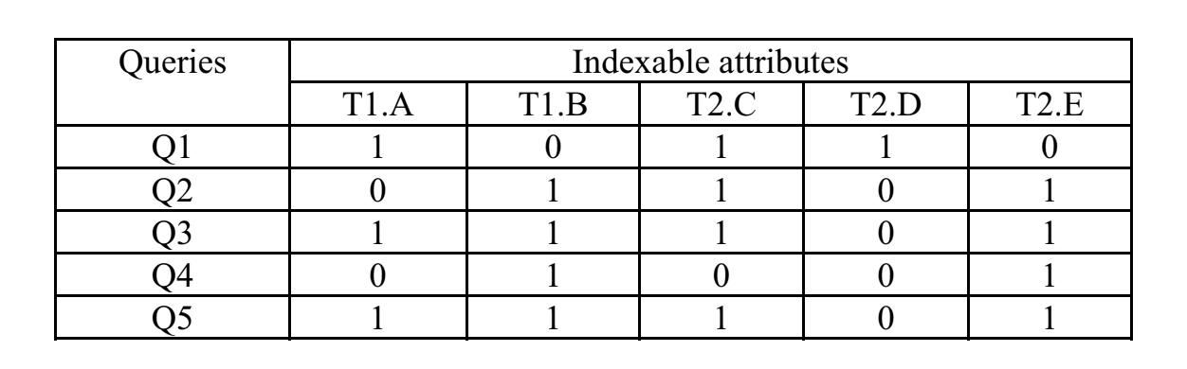
QUERY-ATTRIBUTE MATRIX
“Let columns A and B belong to a table named T1 having 20 rows and C, D and E belonging to a table named T2 having 15 rows” ^{[1]}
^{[1]}
Notes:
Speaker: Emily
The example I’ll give today is an example pulled from Zaman’s thesis. Let columns A and B belong to a table named T1 having 20 rows and C, D and E belonging to a table named T2 having 15 rows. Given a set of 5 queries that each reference certain attributes, we can expect a query attribute matrix similar to this example. Again, the 1’s represent where an attribute appears in each query, and a 0 represented where an attribute is missing in each query.

Slide 13
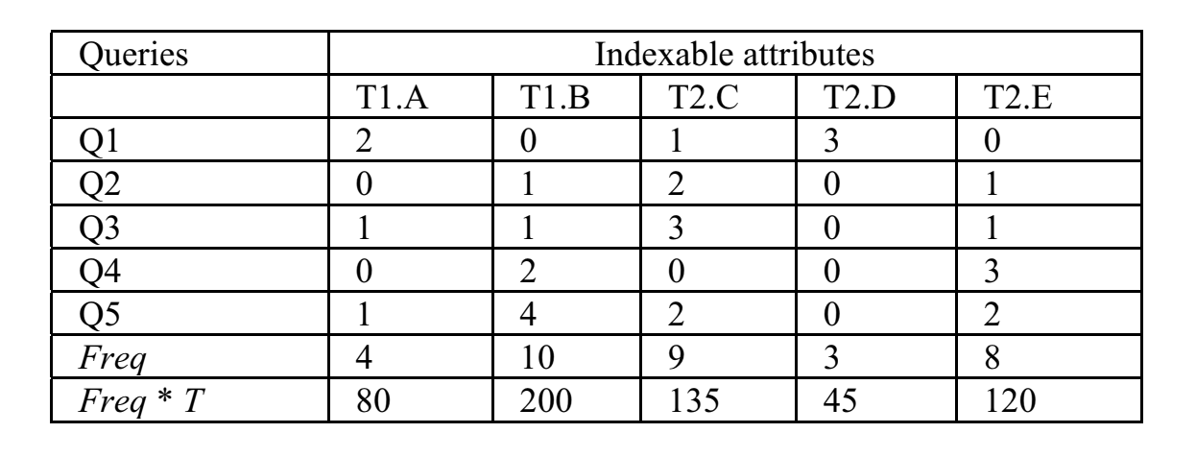
QUERY-FREQUENCY MATRIX
^{[1]}
Notes:
Speaker: Emily
With a populated query attribute matrix, we are then able to traverse through the queries once again based on attributes present and obtain exact numbers for their frequencies in the queries. This screenshot was also pulled from Zaman’s thesis, but contains one item we don’t use, which would be Freq * T. Initially Zaman had two thresholds, threshold one and threshold two, defined by being equal to respectively, workload size divided by two and workload size divided by four. We decided as a team since we’re already comparing our algorithm with another auto-indexing algorithm, that indeed one threshold would suffice, so we got rid of both threshold two and Freq * T, which is what threshold two would of been compared to.
Once we have all the data calculated in the query frequency matrix, along with the frequencies for each attribute, we then step through the matrix and compare each attribute’s frequency with threshold one. The point of threshold one, according to Zaman’s thesis, is to “eliminate the attributes that do not occur very frequently in the workload”. This means that any attribute that has a frequency that is less than threshold one in our query frequency matrix gets removed in our query attribute matrix. Again, this is to prevent over indexing.

Slide 14
K-MEANS
Notes:
Speaker: Emily
Once we have two populated matrices, and have found our so called candidate indexable attributes, we then move on to the heart of our algorithm - clustering.
K-means is classified as an unsupervised machine learning algorithm, but is also labeled as a clustering algorithm. It is labeled as an unsupervised machine learning algorithm because it learns on past knowledge, and doesn’t require a human to give it feedback to learn.
K-means comes down to an incredibly simple concept. Given an initial set of cluster centroids, the number of centroids k, and a dataset, it computes the euclidean distance between all data points, and finds which data point is closest to which given cluster centroid. Once it sets all data points to a certain cluster, it then takes the average of those data points and sets that as it’s new cluster centroid. A fancy gif of the process is shown in this slide.
For us, because we used Sklearn, an external open source Python library, our K-means went the extra mile and actually randomly generated initial centroids for us, all we had to do was pass it the K value and the data set.
It’s also important to note that this algorithm helps solve NP-hard problems, like the Index Selection Problem.
For our algorithm specifically, we cluster on the query attribute matrix, and set the k value equal to 3. We came to the conclusion of sticking with a K value of 3 mainly because Zaman used a bunch of dynamic parameters in her thesis, including different k values for her project. She found that k values from 3 up to 50 yield the best result at about 22 queries, which is how many we used to benchmark, and hence why we decided to just stick to k equals 3.
Once we cluster all the candidate indexable attributes, we then traverse through our new K-means results and find the most common candidate indexable attribute for each cluster. Once done, we pass the results back to Dexter.

Slide 15
PROPOSED WORK & RESULTS: DEXTER INTEGRATION
https://github.com/ankane/dexter
Has its own index suggestion algorithm
Calls our algorithm zaman.py
Cross reference indexes suggested by its own algorithm with indexes suggested by zaman.py
Create indexes based on the candidate keys from the plan with the lowest overall cost.
Notes:
Speaker: Charlie
Dexter is an postgresql extension written in ruby with the goal of automatically indexing a postgreSQL database. It works in two phases: collection and generation.
For the collection phase, it uses the pg_query open source library to parse through the database log files, and detect the queries being run to identify the workload. It group the queries together if they have the same parse tree.
After information about the workload is collected, it moves on to generating hypothetical indexes via another open source library called hypoPG. This make use of the EXPLAIN ANALYZE feature of postgreSQL’s planner to test various execution plans using the hypothetical indexes without actually creating them. This create a set of plans with different indexes and rank them by cost.
We added zaman.py to Dexter, so sets of hypothetical indexes are created using zaman’s algorithm, and the two sets from dexter and zaman’s algorithm is cross referenced to prioritize plans suggested by both algorithm > plans suggested by zaman’s > plans suggested by Dexter. Our reasoning is Zaman’s algorithm is based on clustering while Dexter is based on the execution cost, so if there is an intersect, it would in theory be a plan that’s low in cost and suit our workload’s query frequencies.
In the end the plan with the lowest cost will be selected and it’s hypothetical indexes implemented.

Slide 16
PROPOSED WORK & RESULTS: Measuring Performance
How do we measure performance accurately and with valid metrics?
Transaction Processing Performance Council
TPC-H
Notes:
Speaker: Dragon
//script goes here

Slide 17
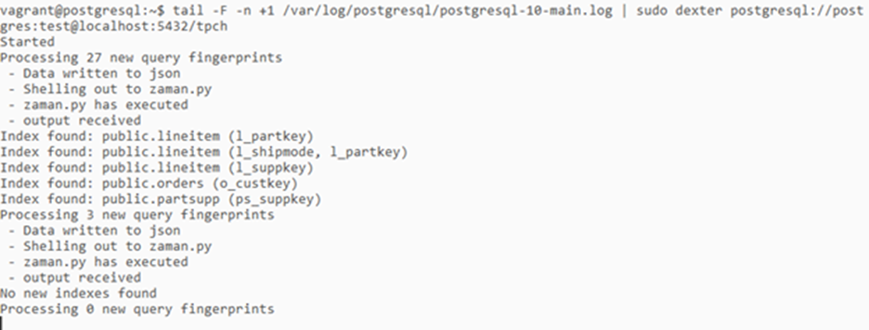
PROPOSED WORK & RESULTS: Results
(Screenshot of our implementation in action)

Slide 18
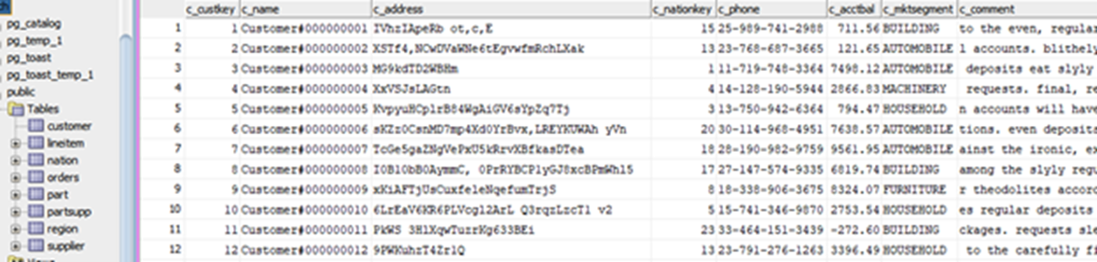
PROPOSED WORK & RESULTS: Results
(Screenshot of the populated database)

Slide 19
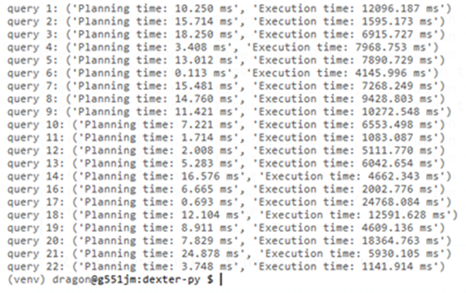
PROPOSED WORK & RESULTS: Results
(Screenshot of benchmark)

Slide 20
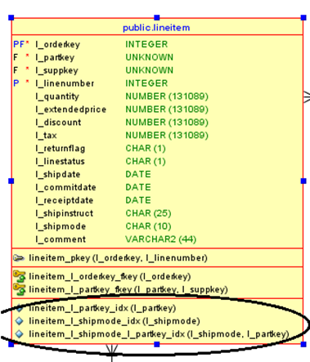
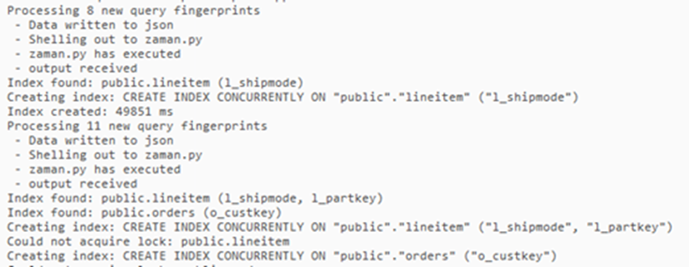
PROPOSED WORK & RESULTS: Results
(Screenshot of indexes being created)

Slide 21
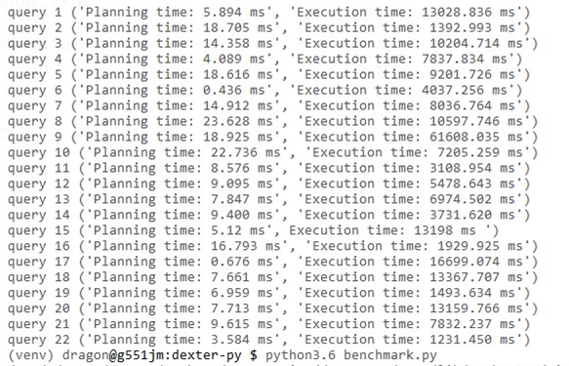
PROPOSED WORK & RESULTS: Experiments / Benchmarking
(Benchmarks before and after created indexes)

Slide 22
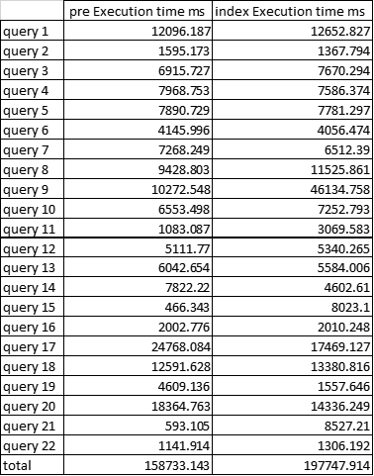
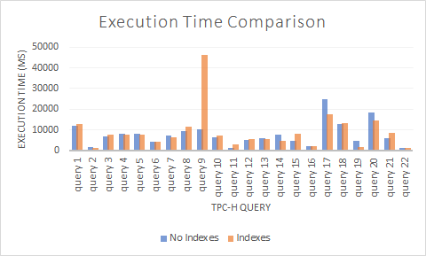
PROPOSED WORK & RESULTS: Experiments / Benchmarking
(Benchmark comparison)

Slide 23
PROPOSED WORK & RESULTS: Experiment Results
Expected execution time to improve after creating indexes
Observed that total execution time for indexed benchmarks is greater than non-indexed benchmarks
Unexpected
Despite this, the worst performing queries improved overall in the indexed benchmarks
Without accounting for outliers, indexed benchmarks total execution times is less than non-indexed benchmarks total execution time

Slide 24
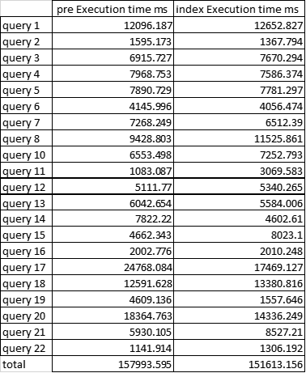
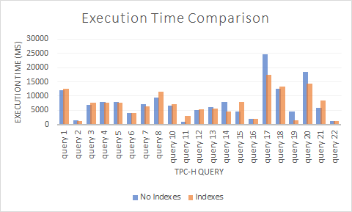
PROPOSED WORK & RESULTS: Experiments Results
(Benchmark comparisons without Query 9)

Slide 25
CONCLUSIONS & FUTURE WORK:
Learnt about auto indexing, data mining through clustering, working with postgreSQL and it’s extensions.
Automatic index creation improve the performance of a workload, but each individual query may not receive the benefits equally.
Future works:
Investigate the cause for query 9’s unusual increase in execution time
More thresholds to narrow down the list of candidate indexes
Experiment with other clustering algorithms such as DBSCAN or HDBSCAN
Rewrite the extension in another language (such as python) to make it easier to understand and better accommodate our algorithm
Notes:
Speaker: Charlie
In conclusion, this project has been an excellent learning experience. Throughout the course of the semester, we gained understanding of auto indexing and data mining through clustering by actively working with postgreSQL, modify and using its many open source extensions.
We also learnt for individual queries in a workload, our implementation does not give individual queries equal performance benefits, but the workload as a whole should have a better execution time as a result of the index implementation.
For future works, query 9’s unexpected outcome should definitely be investigated: is it due to the platform (VM) we ran on or due to an bug in our implementation?
Additionally, more thresholds could be introduced in our algorithm to narrow down the list of good candidate plans/indexes, which may lead to improvement in algorithm performance by reducing the number of plans it has to compare before selecting one to implement.
Experimenting with other clustering algorithm like DBSCAN or HDBSCAN could have more accurate clustering and better performance for large dataset when compared to KMeans, and they should be easy to implement in the python platform since they are included in the sklearn clustering suite.
Since our algorithm is written in python, it maybe ideal to rewrite the framework of Dexter in python instead of having RUBY calling the python program via the shell.
There are more that could be done with such a complex task as auto indexing, so these are just some ideas with our implementation.
And this concludes our presentation.

Slide 26

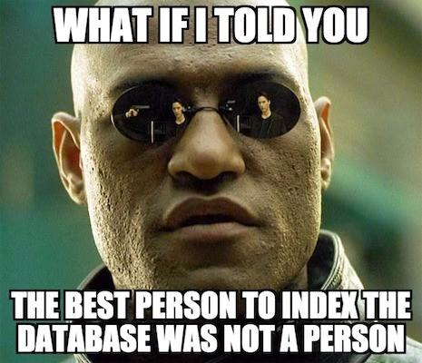
Notes:
And just to lighten the mood, here are some database memes.

Slide 27
REFERENCES:
[1] Kratica, J., Ljubić, I., & Tošić, D. (2003, April). A genetic algorithm for the index selection problem. In Workshops on Applications of Evolutionary Computation (pp. 280-290). Springer, Berlin, Heidelberg.
[2] Piech, C. (2013). K Means. Retrieved April 28, 2018, from http://stanford.edu/~cpiech/cs221/handouts/kmeans.html
[3] Zaman, M., Surabattula, J., & Gruenwald, L. (2004, August). An auto-indexing technique for databases based on clustering. In Database and Expert Systems Applications, 2004. Proceedings. 15th International Workshop on (pp. 776-780). IEEE.

Slide 28
REFERENCES (Continued):
[4] Sun, J., & Hong, J. (2013, October). Index selection: a query pattern mining based approach. In Proceedings of the 2013 Research in Adaptive and Convergent Systems (pp. 100-106). ACM.
[5] Kane, A. (2017, June 27). Introducing Dexter, the Automatic Indexer for Postgres. Retrieved April 29, 2018, from https://medium.com/@ankane/introducing-dexter-the-automatic-indexer-for-postgres-5f8fa8b28f27
[6] Ana Carolina Almeida, Angelo Brayner, José Maria Monteiro, Sérgio Lifschitz, Rafael Pereira de Oliveira. (2016). Automatic Physical Design Tuning based on Hypothetical Plans. Retrieved April 29, 2018, from https://pdfs.semanticscholar.org/8bb4/0a34465d46bcea5eac058b7bc8eb10b8a987.pdf

Slide 29
REFERENCES (Continued):
[7]Schnaitter, Karl, & Abiteoul, Serge & Milo, Tova & Polyzotis, Neoklis. (2007) “On-Line Index Selection for Shifting Workloads.” ACM Digital Library, IEEE Computer Society, dl.acm.org/citation.cfm?id=1547623.
[8] Pedrozo, Wendel & Gomes Vaz, Maria Salete. (2014). A Tool for Automatic Index Selection in Database Management Systems. Proceedings - 2014 International Symposium on Computer, Consumer and Control, IS3C 2014. 1061-1064. 10.1109/IS3C.2014.277.
[9] Schnaitter, Karl & Polyzotis, Neoklis. (2010). Semi-Automatic Index Tuning: Keeping DBAs in the Loop. Computing Research Repository - CORR. 5.

Slide 30
REFERENCES (Continued):
[10] Transaction Processing Performance Council. (1992, August 13). TPC Benchmark C. Retrieved from http://www.tpc.org/tpc_documents_current_versions/pdf/tpc-c_v5.11.0.pdf
[11] Transaction Processing Performance Council. (1999, June). TPC Benchmark H. Retrieved from http://www.tpc.org/tpc_documents_current_versions/pdf/tpc-h_v2.17.3.pdf

